Slide 1
Help Wanted Online
A
real-time measure of job
postings
October 2024
Office of Research
Connecticut Department of
Labor
Connecticut Department of Labor – Research Office
200 Folly Brook Blvd.
Wethersfield, CT 06109
Help Wanted Online
Connecticut Department of Labor – Research Office
200 Folly Brook Blvd.
Wethersfield, CT 06109
1

Slide 2
What is HWOL?
The Conference Board Help Wanted Online® Data Series (HWOL) measures the number of new, first-time Online job postings and jobs reposted from the previous month for over 50,000 Internet job boards, corporate boards and smaller job sites that serve niche markets and smaller geographic areas.
This document contains
information
on
monthly
total
job
ad
counts for
August
2024.
Connecticut Department of Labor – Research Office
200 Folly Brook Blvd.
Wethersfield, CT 06109
Help Wanted
Online
Connecticut Department of Labor – Research Office
200 Folly Brook Blvd.
Wethersfield, CT 06109
2

Slide 3
Upcoming Release Dates
Monthly Report:
November 13th, 2024
Weekly New Ads Report:
Updated
every
Tuesday
Connecticut Department of Labor – Research Office
200 Folly Brook Blvd.
Wethersfield, CT 06109
Help Wanted Online
Connecticut Department of Labor – Research Office
200 Folly Brook Blvd.
Wethersfield, CT 06109
3

Slide 4
Statewide Weekly HWOL New Job Ads
Information on weekly new job ads by Employer, Industry,
and Occupation can be found at:
http s :/ / w w w1 . c td o l. state. c t. u s / lm i/ hwo l. as p
This
Information is updated every Tuesday.
Connecticut Department of Labor – Research Office
200 Folly Brook Blvd.
Wethersfield, CT 06109
Help Wanted Online
Connecticut Department of Labor – Research Office
200 Folly Brook Blvd.
Wethersfield, CT 06109
4

Slide 5
Statewide Monthly Highlights
- Total postings in Connecticut was 79,160 in September 2024, down from an
August 2024 posting count of 82,219.
-Industry sectors with the most job postings were Health Care and Social
Assistance (15,934 postings), Retail Trade (8,639 posting), Manufacturing (6,433 postings), and Professional, Scientific, & Technical Occupations (5,026 postings).
-Occupations with the most postings were Registered Nurses (4,397 postings),
Retail Salespersons (3,024 postings), Home Health & Personal Care Aides
(1,770 postings), and Supervisors of Retail Sales Workers (1,607 postings).
Connecticut Department of Labor – Research Office
200 Folly Brook Blvd.
Wethersfield, CT 06109
Help Wanted Online
Connecticut Department of Labor – Research Office
200 Folly Brook Blvd.
Wethersfield, CT 06109
5

Slide 6
Top Qualifications
in Connecticut
Qualification
Job
Ads
Qualification
Ads
Ads
Valid Driver's License
9,717
Certified Public Accountant
369
Registered Nurse (RN)
5,567
Pediatric Advanced Life Support (PALS)
362
Cardiopulmonary Resuscitation (CPR) Cert.
3,334
Drug Enforcement Agency (DEA) License
352
Basic Life Support (BLS) Cert.
2,288
Automated External Defibrillator (AED) Cert.
313
First Aid Cert.
1,569
Physician Assistant - Certified (PA-C)
291
Certified Nursing Assistant (CNA)
1,368
CDL Class A License
280
Licensed Practical Nurse (LPN)
1,060
Board Certified Behavior Analyst (BCBA)
275
Nurse Practitioner (APRN-CNP)
943
Medical License
275
Master Of Business Administration (MBA)
844
American Red Cross (ARC) Cert.
248
Board Certified/Board Eligible
792
Licensed Master Social Worker
247
Security Clearance
700
Certified Patient Care Technician (CPCT)
244
Advanced Cardiovascular Life Support (ACLS) Cert.
682
American Registry Of Radiologic Technologists (ARRT) Certified
220
Advanced Practice Registered Nurse
640
Certified Medical Assistant (CMA)
218
Licensed Clinical Social Worker (LCSW)
623
10-Hour OSHA General Industry Card
214
Commercial Driver's License (CDL)
618
Bachelor Of Science in Nursing (BSN)
210
Basic Cardiac Life Support
525
Phlebotomy Cert.
209
Certified Pharmacy Technician
522
Professional Engineer (PE) License
203
Automotive Service Excellence (ASE) Cert.
484
Certified Information Systems Security Professional
192
ServSafe Cert.
483
Family Nurse Practitioner (FNP)
192
Licensed Professional Counselor (LPC)
457
Registered Behavior Technician (RBT)
185
Teaching Certificate
449
CDL Class B License
180
Licensed Marriage And Family Therapist (LMFT)
403
Secret Clearance
164
Project Management Professional Cert.
384
Forklift Cert.
162
Registered Pharmacist (RPh)
383
ANCC Certified
160
Emergency Medical Technician (EMT)
379
Neonatal Resuscitation Program Cert. (NRP)
158
Connecticut Department of Labor – Research Office
200 Folly Brook Blvd.
Wethersfield, CT 06109
Help Wanted Online
Connecticut Department of Labor – Research Office
200 Folly Brook Blvd.
Wethersfield, CT 06109
6

Slide 7
Top
Skills
in
Connecticut
Job
Ads
Skill Categories Ads
Specialized Skills Ads
Nursing 6,184
Merchandising 5,137
Project Management 5,028
Marketing 4,863
Auditing 4,175
Selling Techniques 3,796
Finance 3,197
Accounting 2,964
Workflow Management 2,858
Housekeeping 2,795
Continuous Improvement Process 2,700
Inventory Management 2,626
Billing 2,598
Medical Records 2,472
Effective Communication 2,403
Restaurant Operation 2,398
Data Analysis 2,293
Customer Relationship Management 2,268
Process Improvement 2,227
Warehousing 2,203
Software Skills Ads
Communication 40,119
Microsoft Office 6,699
Personal Attributes 32,754
Microsoft Excel 6,550
Initiative and Leadership 32,397
Microsoft Outlook 3,472
Customer Service 23,358
Microsoft PowerPoint 3,347
Business Management 21,208
Microsoft Word 2,292
Business Operations 19,236
SQL (Programming Language) 1,261
Critical Thinking and Problem Solving 19,102
Python (Programming Language) 1,158
General Sales Practices 17,179
Salesforce 991
Regulation and Legal Compliance 16,339
SAP Applications 898
Project Management 15,695
Spreadsheets 838
Office and Productivity Equipment and Te 13,084
Epic EMR 779
Nursing and Patient Care 12,126
Amazon Web Services 728
Social Skills 11,534
Inventory Management System 668
Writing and Editing 11,230
Application Programming Interface (API) 631
Language Competency 10,117
Microsoft Azure 626
Physical Abilities 9,945
Dashboard 584
Basic Technical Knowledge 9,770
Operating Systems 574
General Medicine 9,224
Microsoft Access 542
Occupational Health and Safety 8,755
Power BI 535
Teaching 8,680
R (Programming Language) 457
Connecticut Department of Labor – Research Office
200 Folly Brook Blvd.
Wethersfield, CT 06109
Help Wanted Online
Connecticut Department of Labor – Research Office
200 Folly Brook Blvd.
Wethersfield, CT 06109
7

Slide 8
Connecticut Job Ads by Industry
September 2024
Industry
Job Ads
Total
Health Care and Social Assistance
Retail Trade
Manufacturing
Pro., Sci., & Tech.
Services Finance and
Insurance Educational
Services
Accommodation and Food
Services Administrative and
Support Wholesale Trade
Other Services (except Public
Admin.) Construction
Transportation and Warehousing
Information
Public Administration
Real Estate and Rental and Leasing
Utilities
Arts, Entertainment, and Recreation
Management
Agriculture
Mining, Quarrying, and Extraction
Unspecified
79,160
15,934
8,639
6,433
5,215
5,026
4,066
3,493
2,455
2,333
2,063
1,826
1,667
1,630
1,448
1,178
627
617
214
106
92
14,098
Source: CT DOL Analysis of HWOL
Connecticut Department of Labor – Research Office
200 Folly Brook Blvd.
Wethersfield, CT 06109
Help Wanted Online
Connecticut Department of Labor – Research Office
200 Folly Brook Blvd.
Wethersfield, CT 06109
8

Slide 9
Connecticut
Employers
with the Most
Job Ads
Employer
Ads
Employer (continued)
Ads
Hartford HealthCare
Yale New Haven Health
CVS Health
Nuvance
Health Yale
University
State Of Connecticut
Walmart
Compass
Group Cigna
Travelers
Walgreens Boots Alliance
Trinity Health
Advance
Stores Echn
Arinc International Of
Canada Middlesex Health
System Eversource Energy
Optum
Marrakech
Marriott International
UnitedHealth Group
University of
Connecticut Apple
The Hartford
2,087
1,624
897
655
499
498
490
420
400
387
357
350
343
330
323
299
296
293
277
273
262
262
256
255
Lumen Technologies
Starbucks
TJX
Raytheon Technologies
BJ's Wholesale Club
US Depart. of the Treasury
Accenture
Dattco
ASML
Stamford Health
Ltd Bank of
America Target
Masonicare
Global Partners
General
Dynamics Baskin
Robbins
CT Children's Medical Center
YMCA
Benchmark Senior Living
Elevance Health
Es Boulos
Ernst &
Young M&T
Bank
241
237
227
208
205
204
203
198
192
174
173
173
172
170
164
163
160
160
152
151
147
146
139
Connecticut Department of Labor – Research Office
200 Folly Brook Blvd.
Wethersfield, CT 06109
Help Wanted Online
Connecticut Department of Labor – Research Office
200 Folly Brook Blvd.
Wethersfield, CT 06109
9

Slide 10
Connecticut
Occupations with the Most Job Ads
Occupation
Ads
Occupation
Ads
Registered Nurses
Retail Salespersons
Home Health & Personal Care
Aides Supervisors of Retail Sales
Workers Customer Service
Representatives
Sales Representatives, Wholesale & Manufacturing
General & Operations Managers
Secretaries & Administrative
Assistants Medical & Health Services
Managers Heavy & Tractor-Trailer
Truck Drivers Software Developers
Computer Occupations, All Other
Fast Food & Counter Workers
Supervisors of Office & Administrative Support Workers
Project Management Specialists
Financial Managers
Sales Representatives of Services
Nurse Practitioners
Food Service
Managers Nursing
Assistants Sales
Managers
Maintenance & Repair Workers, General
Medical Assistants
Technical & Scientific Products Sales Representatives
Preschool Teachers, Except Special Education
4,397
3,024
1,770
1,607
1,214
1,118
1,092
1,059
1,021
1,001
944
937
898
867
740
721
702
669
666
665
662
658
638
619
617
Laborers & Freight, Stock, & Material Movers
Financial Managers
Security Guards
Waiters &
Waitresses
Accountants & Auditors
Medical Secretaries & Administrative Assistants
Marketing Managers
Preschool Teachers, Except Special Education
Cashiers
Management Analysts
Marriage & Family Therapists
Supervisors of Office & Admin. Support Workers
Project Management Specialists
Automotive Service Technicians & Mechanics
Computer User Support Specialists
Industrial Engineers
Merchandise Displayers & Window Trimmers
Coaches & Scouts
Maids & Housekeeping Cleaners
Driver/Sales Workers
Pharmacy Technicians
Supervisors of Food Preparation & Serving Workers
Middle School Teachers
Production Workers, All
Other Light Truck Drivers
616
613
605
603
588
563
512
511
508
487
486
468
468
463
459
457
454
435
435
427
425
402
400
395
390
Connecticut Department of Labor – Research Office
200 Folly Brook Blvd.
Wethersfield, CT 06109
Help Wanted Online
Connecticut Department of Labor – Research Office
200 Folly Brook Blvd.
Wethersfield, CT 06109
10

Slide 11
Top
Occupations in Industries With The
Most
Ads
Top Three Occupations in Industries With The Most Ads - September 2024
All Industries - CT Statewide
Registered Nurses
Retail Salespersons
Home Health and Personal Care Aides
79,160
4,397
3,024
1,770
Health Care and Social Assistance
Registered Nurses
Home Health and Personal Care Aides
Nurse Assistants
15,934
3,189
972
544
Retail Trade
Retail Salespersons
First-Line Supervisors of Retail Sales Workers
Pharmacy Technicians
8,639
1,892
930
330
Manufacturing
Production Workers
Industrial Engineers
Wholesale & Manuf. Sales Representatives
6,433
246
190
175
Professional, Scientific, and Technical Services
Software Developers
Computer
Occupations Tax
Preparers
5,215
227
226
172
Source: CT DOL Analysis of Help Wanted Online
Connecticut Department of Labor – Research Office
200 Folly Brook Blvd.
Wethersfield, CT 06109
Help Wanted Online
Connecticut Department of Labor – Research Office
200 Folly Brook Blvd.
Wethersfield, CT 06109
11

Slide 12
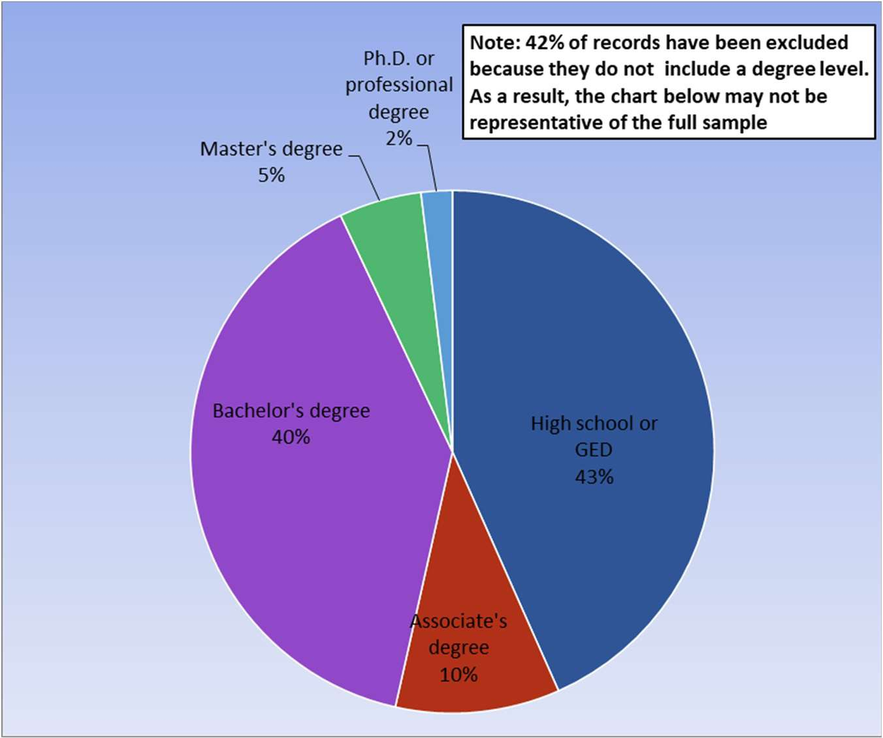
Connecticut Job Ads by Educational
Requirements
Connecticut Department of Labor – Research Office
200 Folly Brook Blvd.
Wethersfield, CT 06109
Help Wanted Online
Connecticut Department of Labor – Research Office
200 Folly Brook Blvd.
Wethersfield, CT 06109
12

Slide 13
Workforce Area
Data
-
-
-
-
-
Workforce
Job Ads by
Job Ads by
Employers
Area Highlights
Industry
Location
With The Most Job Ads
Occupations With The Most Job Ads
Connecticut Department of Labor – Research Office
200 Folly Brook Blvd.
Wethersfield, CT 06109
Help Wanted Online
Connecticut Department of Labor – Research Office
200 Folly Brook Blvd.
Wethersfield, CT 06109
13

Slide 14
Workforce
Area
Highlights
Workforce Area
September
2024
Total Ads
Industry Sector
With Most Ads
Ads
Occupation
With Most Ads
Ads
Eastern
6,822
Health Care and Social
Assistance
1,608
Registered Nurses
360
North Central
27,451
Health Care and Social
Assistance
4,706
Registered Nurses
1,277
Northwest
10,410
Health Care and Social
Assistance
2,575
Registered Nurses
647
South Central
14,434
Health Care and Social
Assistance
3,709
Registered Nurses
1,141
Southwest
17,369
Health Care and Social
Assistance
2,967
Registered Nurses
4,397
Source: CT DOL Research Office Analysis of HWOL Data Series
Connecticut Department of Labor – Research Office
200 Folly Brook Blvd.
Wethersfield, CT 06109
Help Wanted Online
Connecticut Department of Labor – Research Office
200 Folly Brook Blvd.
Wethersfield, CT 06109
14

Slide 15
Eastern WDA Job Ads by Industry
September 2024
Industry
Job Ads
Total
Health Care and Social Assistance
Retail Trade
Manufacturing
Educational
Services
Accommodation and Food Services
Administrative and
Support Pro., Sci., & Tech.
Services Wholesale Trade
Public Administration Finance
and Insurance Transportation
and Warehousing Construction
Other Services (except Public
Admin.) Utilities
Real Estate and Rental and Leasing
Information
Mining, Quarrying, and Extraction
Arts, Entertainment, and
Recreation Management
Agriculture
Unspecified
6,822
1,608
811
671
530
297
288
267
200
177
169
145
120
118
74
59
38
32
23
12
8
1,175
Source: CT DOL Analysis of HWOL
Connecticut Department of Labor – Research Office
200 Folly Brook Blvd.
Wethersfield, CT 06109
Help Wanted Online
Connecticut Department of Labor – Research Office
200 Folly Brook Blvd.
Wethersfield, CT 06109
15

Slide 16
Eastern Workforce
Job Ads by Location
Location
Postings
Location (continued)
Postings
Norwich, CT
Groton, CT
New London, CT
Windham, CT
Waterford, CT
Mansfield, CT
Montville, CT
Putnam, CT
Killingly, CT
East Lyme, CT
Colchester, CT
Ledyard, CT
Plainfield, CT
Stonington, CT
Old Lyme, CT
North Stonington,
CT Coventry, CT
Thompson, CT
982
933
824
497
445
406
404
360
336
212
174
173
167
129
86
72
71
67
Brooklyn, CT
Willington, CT
Pomfret, CT
Woodstock, CT
Bozrah, CT
Columbia, CT
Preston, CT
Lebanon, CT
Ashford, CT
Eastford, CT
Canterbury, CT
Salem, CT
Sterling, CT
Hampton, CT
Chaplin, CT
Voluntown, CT
Scotland, CT
65
63
43
43
41
38
33
27
26
24
23
19
17
10
6
4
2
Connecticut Department of Labor – Research Office
200 Folly Brook Blvd.
Wethersfield, CT 06109
Help Wanted Online
Connecticut Department of Labor – Research Office
200 Folly Brook Blvd.
Wethersfield, CT 06109
16

Slide 17
Eastern Workforce Employers
with
the
Ads
Most Job
Employer (continued)
Ads
Employer
Ads
Hartford HealthCare
Yale New Haven
Health General
Dynamics Mohegan
Sun
University of Connecticut
Pfizer
Day Kimball Hospital
Walmart
Compass
Group Advance
Stores
New London Public Schools
CVS Health
Walgreens Boots
Alliance East Lyme
Public Schools Windham
Public Schools State of
Connecticut Careco
Shoreline
BJ's Wholesale
Club Global
Partners Optum
Amentum
Groton
Chelsea Groton Bank
294
234
161
151
134
118
114
81
68
66
63
60
52
42
39
34
31
29
28
28
26
26
25
Connecticut College
Thames Valley Council For Comm. Action
Hhm Hotels
Frito Lay
Lyft
Abi Resources
Bob's Discount Furniture
Echn
Community Health Resources
Dattco
Dominion Energy
Domino's Pizza
Eversource
Energy
CW Resource Services
Corp. Marriott
International United
Services
ALDI
Benchmark Senior Living
Eastern Connecticut State
University Generations Family
Health Center AutoZone
Buffalo Wild Wings
Child & Family
25
24
23
22
22
21
20
19
18
18
18
18
18
17
17
17
15
15
15
15
14
14
14
Connecticut Department of Labor – Research Office
200 Folly Brook Blvd.
Wethersfield, CT 06109
Help Wanted Online
Connecticut Department of Labor – Research Office
200 Folly Brook Blvd.
Wethersfield, CT 06109
17

Slide 18
Eastern WDA Occupations
with
the
Most Job Ads
Occupation
Ads
Occupation
Ads
Registered Nurses
Retail Salespersons
Home Health & Personal Care Aides
Supervisors of Retail Sales Workers
Secretaries & Administrative
Assistants Customer Service
Representatives
Fast Food & Counter Workers
Heavy & Tractor-Trailer Truck Drivers
Nurse Practitioners
Teaching Assistants, Except Postsecondary
Janitors & Cleaners
Medical & Health Services Managers
General & Operations Managers
Laborers & Freight, Stock, & Material
Movers Maintenance & Repair Workers,
General Health Technologists & Technicians,
All Other Supervisors of Food Prep. &
Serving Workers Medical Assistants
Nursing Assistants
Waiters & Waitresses
Secondary School
Teachers
Maids & Housekeeping Cleaners
Licensed Practical & Licensed Vocational Nurses
Dining Room & Cafeteria Attendants & Bartender Helpers
Pharmacy Technicians
360
301
234
142
128
102
99
97
92
82
79
77
76
73
71
64
64
59
58
58
57
56
55
52
51
Food Service Managers
Financial Managers
Security Guards
Waiters &
Waitresses
Accountants & Auditors
Medical Secretaries & Administrative Assistants
Marketing Managers
Preschool Teachers, Except Special Education
Cashiers
Management Analysts
Marriage & Family Therapists
Supervisors of Office & Admin. Support Workers
Project Management Specialists
Automotive Service Technicians & Mechanics
Computer User Support Specialists
Industrial Engineers
Merchandise Displayers & Window Trimmers
Coaches & Scouts
Maids & Housekeeping Cleaners
Driver/Sales Workers
Pharmacy Technicians
Supervisors of Food Prep. & Serving Workers
Middle School Teachers
Production Workers, All
Other Light Truck Drivers
49
49
47
47
46
45
45
45
45
43
42
42
41
41
41
40
37
37
36
35
35
33
33
31
30
Connecticut Department of Labor – Research Office
200 Folly Brook Blvd.
Wethersfield, CT 06109
Help Wanted Online
Connecticut Department of Labor – Research Office
200 Folly Brook Blvd.
Wethersfield, CT 06109
18

Slide 19
North Central WDA Job Ads by Industry
September 2024
Industry
Job Ads
Total
Health Care and Social Assistance
Retail Trade
Finance and Insurance
Manufacturing
Pro., Sci., & Tech. Services
Accommodation and Food
Services Educational Services
Information Wholesale
Trade Administrative and
Support Construction
Other Services (except Public
Admin.) Real Estate and Rental and
Leasing Transportation and
Warehousing Public Administration
Utilities
Arts, Entertainment, and Recreation
Management
Mining, Quarrying, and Extraction
Agriculture
Unspecified
27,451
4,706
2,746
2,576
2,338
2,271
1,163
1,038
792
788
787
762
715
594
591
477
270
191
47
22
21
4,556
Source: CT DOL Analysis of HWOL
Connecticut Department of Labor – Research Office
200 Folly Brook Blvd.
Wethersfield, CT 06109
Help Wanted Online
Connecticut Department of Labor – Research Office
200 Folly Brook Blvd.
Wethersfield, CT 06109
19

Slide 20
North Central
Location
WDA
Postings
Job Ads by Location
Location (continued)
Postings
Hartford, CT
Farmington, CT
New Britain, CT
Manchester, CT
West Hartford, CT
East Hartford, CT
Bloomfield, CT
Windsor, CT
Bristol, CT
Rocky Hill, CT
Southington, CT
Enfield, CT
Glastonbury, CT
Windsor Locks, CT
Newington, CT
South Windsor, CT
Berlin, CT
Simsbury, CT
9,498
1,382
1,357
1,228
1,219
1,130
1,112
939
927
837
805
724
667
646
642
615
450
418
Avon, CT
Wethersfield, CT
Plainville, CT
Stafford, CT
Canton, CT
East Windsor, CT
East Granby, CT
Granby, CT
Ellington, CT
Tolland, CT
Suffield, CT
Hebron, CT
Somers, CT
Marlborough, CT
Plymouth, CT
Burlington, CT
Bolton, CT
Andover, CT
409
388
377
218
196
181
152
148
141
114
104
98
69
65
65
58
39
33
Connecticut Department of Labor – Research Office
200 Folly Brook Blvd.
Wethersfield, CT 06109
Help Wanted
Online
Connecticut Department of Labor – Research Office
200 Folly Brook Blvd.
Wethersfield, CT 06109
20

Slide 21
North Central WDA Employers
with
the Most Job Ads
Employer
Ads
Employer (continued)
Ads
Hartford HealthCare
CVS Health
Cigna
Travelers
Arinc International Of Canada Ulc
State Of Connecticut
Trinity
Health The
Hartford
Echn
Eversource Energy
Accenture
Marriott International
Raytheon
Technologies Lumen
Technologies
UnitedHealth Group
CT Children's Medical Center
Es Boulos
Optum
YMCA
Walmart
Dattco
University of Connecticut
Baskin Robbins
Cardinal Health
891
484
386
386
301
241
239
234
218
208
203
189
173
155
149
145
129
124
117
111
108
106
103
98
Wheeler Clinic
GovCIO
Prime Therapeutics
Compass Group
Hospital For Special Care
Advance Stores
Ryder
Infosys
Dunkin' Brands
Lincoln Financial Group
CBRE
Capitol Region Education
Council New Britain General
Hospital Webster Bank
Ford
Cai
Apple
Starbucks
Bank of America
AmTrust Financial Services
TJX
Walgreens Boots
Alliance Hartford Public
Schools Bristol Public
Schools
96
95
95
85
83
80
78
75
73
70
67
67
67
60
59
58
57
57
56
55
55
55
53
49
Connecticut Department of Labor – Research Office
200 Folly Brook Blvd.
Wethersfield, CT 06109
Help Wanted Online
Connecticut Department of Labor – Research Office
200 Folly Brook Blvd.
Wethersfield, CT 06109
21

Slide 22
North Central WDA Occupations
with
the
Most Job Ads
Occupation
Ads
Occupation
Ads
Registered Nurses
Retail Salespersons
Software Developers
Computer Occupations, All Other
Supervisors of Retail Sales
Workers Project Management
Specialists
Sales Representatives, Wholesale & Manufacturing
Home Health & Personal Care
Aides Customer Service
Representatives General &
Operations Managers Medical &
Health Services Managers Heavy &
Tractor-Trailer Truck Drivers
Supervisors of Office & Administrative Support Workers
Secretaries & Administrative Assistants
Fast Food & Counter Workers
Financial Managers
Sales Representatives of Services
Sales Managers
Laborers & Freight, Stock, & Material Movers
Food Service Managers
Data Scientists
Maintenance & Repair Workers, General
Accountants & Auditors
Technical & Scientific Products Sales Representatives
Nurse Practitioners
1,277
869
653
544
473
465
462
436
419
405
387
327
324
319
283
282
269
265
252
249
243
230
225
221
217
Marketing Managers
Management Analysts
Teaching Assistants, Except Postsecondary
Waiters &
Waitresses
Managers, All Other
Janitors & Cleaners
Preschool Teachers, Except Special
Education Automotive Service Technicians
& Mechanics Nursing Assistants
Industrial
Engineers Medical
Assistants Civil
Engineers
Production Workers, All Other
Health Technologists & Technicians, All Other
Computer User Support Specialists
Security Guards
Human Resources Specialists
Supervisors of Food Prep. & Serving Workers
Supervisors of Production & Operating
Workers Buyers & Purchasing Agents
Child, Family, & School Social Workers
Financial & Investment Analysts
Community & Social Service Specialists, All Other
Lawyers
Inspectors, Testers, Sorters, Samplers, & Weighers
208
208
186
184
183
178
177
172
171
166
164
163
162
161
158
152
148
148
144
140
139
137
131
131
130
Connecticut Department of Labor – Research Office
200 Folly Brook Blvd.
Wethersfield, CT 06109
Help Wanted Online
Connecticut Department of Labor – Research Office
200 Folly Brook Blvd.
Wethersfield, CT 06109
22

Slide 23
Northwest WDA Job Ads by Industry
September 2024
Industry
Job Ads
Total
Health Care and Social Assistance
Retail Trade
Manufacturing
Educational Services
Wholesale Trade
Accommodation and Food Services
Pro., Sci., & Tech. Services
Finance and Insurance
Administrative and Support
Public Administration
Construction
Other Services (except Public Admin.)
Transportation and Warehousing
Real Estate and Rental and Leasing
Information
Utilities
Arts, Entertainment, and Recreation
Management
Agriculture
Mining, Quarrying, and Extraction
Unspecified
10,410
2,575
1,374
761
566
452
419
381
335
285
280
238
235
207
131
113
69
68
34
30
1
1,856
Source: CT DOL Analysis of HWOL
Connecticut Department of Labor – Research Office
200 Folly Brook Blvd.
Wethersfield, CT 06109
Help Wanted Online
Connecticut Department of Labor – Research Office
200 Folly Brook Blvd.
Wethersfield, CT 06109
23

Slide 24
Northwest
Location
WDA Job Ads by
Location
Postings
Postings
Location
Danbury, CT
Waterbury, CT
Torrington, CT
Ridgefield, CT
Cheshire, CT
New Milford, CT
Newtown, CT
Southbury, CT
Naugatuck, CT
Brookfield, CT
Watertown, CT
Bethel, CT
Canaan, CT
Litchfield, CT
Middlebury, CT
Washington, CT
Thomaston, CT
Sharon, CT
Wolcott, CT
2,587
1,907
870
559
514
424
390
365
345
301
276
256
151
140
135
131
123
109
107
New Hartford, CT
Salisbury, CT
Woodbury, CT
Prospect, CT
New Fairfield, CT
Redding, CT
Kent, CT
Bethlehem, CT
Cornwall, CT
Harwinton, CT
Barkhamsted, CT
Goshen, CT
Norfolk, CT
Bridgewater, CT
Morris, CT
Roxbury, CT
Sherman, CT
Colebrook, CT
95
90
79
74
66
61
54
47
26
26
25
14
14
13
13
11
8
4
Connecticut Department of Labor – Research Office
200 Folly Brook Blvd.
Wethersfield, CT 06109
Help Wanted Online
Connecticut Department of Labor – Research Office
200 Folly Brook Blvd.
Wethersfield, CT 06109
24

Slide 25
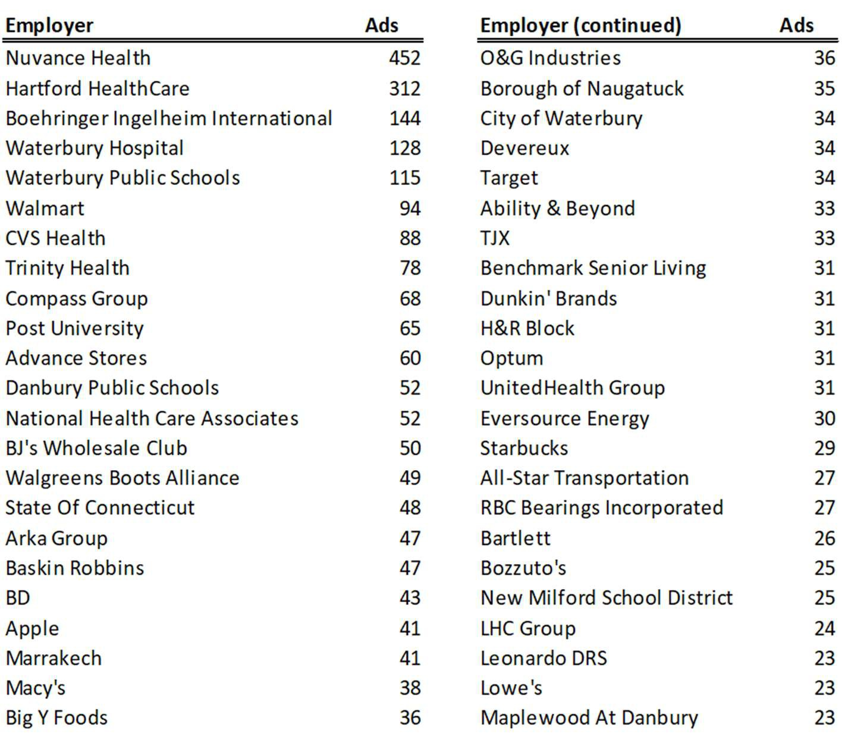
Northwest WDA Employers
with
the
Most
Job Ads
Connecticut Department of Labor – Research Office
200 Folly Brook Blvd.
Wethersfield, CT 06109
Help Wanted Online
Connecticut Department of Labor – Research Office
200 Folly Brook Blvd.
Wethersfield, CT 06109
25

Slide 26
Northwest WDA Occupations
with
the
Most Job Ads
Occupation
Ads
Occupation
Ads
Registered Nurses
Retail Salespersons
Home Health & Personal Care
Aides Supervisors of Retail Sales
Workers Heavy & Tractor-Trailer
Truck Drivers Customer Service
Representatives Nursing Assistants
General & Operations Managers
Medical & Health Services Managers
Fast Food & Counter Workers
Secretaries & Administrative
Assistants
Preschool Teachers, Except Special
Education Health Technologists &
Technicians, All Other Production Workers,
All Other
Licensed Practical & Licensed Vocational Nurses
Supervisors of Office & Administrative Support
Workers Nurse Practitioners
Waiters & Waitresses
Cashiers
Physical Therapists
Sales Representatives, Wholesale & Manufacturing
Medical Assistants
Secondary School
Teachers Janitors &
Cleaners
Teaching Assistants, Except Postsecondary
647
485
346
252
168
165
155
146
143
133
130
115
109
107
104
103
97
97
92
91
90
88
87
83
82
Food Service Managers
Technical & Scientific Products Sales
Representatives Substance Abuse & Mental Health
Counselors Maintenance & Repair Workers,
General
Security Guards
Automotive Service Technicians &
Mechanics Laborers & Freight, Stock, &
Material Movers Merchandise Displayers &
Window Trimmers Pharmacy Technicians
Receptionists & Information Clerks
Community & Social Service Specialists, All Other
Coaches & Scouts
Dining Room Attendants & Bartender Helpers
Child, Family, & School Social Workers
Cooks, Restaurant
Sales Representatives of Services
Sales Managers
Managers, All Other
Supervisors of Food Prep. & Serving Workers
Medical Secretaries & Administrative
Assistants Counselors, All Other
Financial Managers
Bartenders
Driver/Sales
Workers
Special Education Teachers, All Other
81
78
76
73
71
68
68
67
66
64
63
62
62
61
60
59
58
58
58
57
52
51
51
47
45
Connecticut Department of Labor – Research Office
200 Folly Brook Blvd.
Wethersfield, CT 06109
Help Wanted Online
Connecticut Department of Labor – Research Office
200 Folly Brook Blvd.
Wethersfield, CT 06109
26

Slide 27
South Central WDA Job Ads by Industry
September 2024
Industry
Job Ads
Total
Health Care and Social Assistance
Retail Trade
Manufacturing
Educational
Services
Accommodation and Food Services
Pro., Sci., & Tech. Services
Finance and Insurance
Administrative and
Support
Other Services (except Public
Admin.) Wholesale Trade
Transportation and Warehousing
Construction
Public Administration
Real Estate and Rental and Leasing
Information
Utilities
Arts, Entertainment, and Recreation
Management
Agriculture
Mining, Quarrying, and Extraction
Unspecified
14,434
3,709
1,575
1,012
863
712
639
627
449
371
367
329
297
258
171
139
132
128
39
17
11
2,589
Source: CT DOL Analysis of HWOL
Connecticut Department of Labor – Research Office
200 Folly Brook Blvd.
Wethersfield, CT 06109
Help Wanted Online
Connecticut Department of Labor – Research Office
200 Folly Brook Blvd.
Wethersfield, CT 06109
27

Slide 28
South Central WDA
Job Ads by
Location
Location
Postings
Location
Postings
New Haven, CT
Middletown, CT
Milford, CT
Wallingford, CT
Meriden, CT
North Haven, CT
Hamden, CT
Orange, CT
West Haven, CT
Branford, CT
Cromwell, CT
Clinton, CT
Guilford, CT
Old Saybrook, CT
Madison, CT
4,209
1,409
1,147
1,094
823
772
752
583
463
453
381
340
320
252
224
East Haven, CT
Westbrook, CT
Essex, CT
North Branford, CT
Durham, CT
East Hampton, CT
Portland, CT
Woodbridge, CT
Haddam, CT
East Haddam, CT
Bethany, CT
Chester, CT
Deep River, CT
Middlefield, CT
Killingworth, CT
195
122
106
94
92
88
87
69
66
62
58
56
55
45
17
Connecticut Department of Labor – Research Office
200 Folly Brook Blvd.
Wethersfield, CT 06109
Help Wanted Online
Connecticut Department of Labor – Research Office
200 Folly Brook Blvd.
Wethersfield, CT 06109
28

Slide 29
South Central WDA Employers
with
the Most Job Ads
Employer
Ads
Employer (continued)
Ads
Yale New Haven Health
Yale University
Saint Francis Hospital
Middlesex Health
System Hartford
HealthCare Marrakech
Elevance Health
Walmart
Children's Health Orange County
Medtronic
Walgreens Boots Alliance
CVS Health
State Of Connecticut
Masonicare
Avangrid
Compass
Group
ShopRite
Optum
Quinnipiac University
Midstate Medical
Center TJX
US Depart. of the Treasury
Advance
Stores Global
Partners
Dattco
854
479
345
295
222
171
126
122
120
107
104
99
98
85
75
57
57
50
50
48
47
47
45
44
40
Alexion Pharmaceuticals
Burns & McDonnell
Adelbrook
Bowlero Corporation
Benchmark Senior Living
Gaylord Specialty
Healthcare Wesleyan
University
BJ's Wholesale Club
Board Of County Commissioners
Headway
Starbucks
Assa Abloy
Pieper Veterinary
Hospital University of
New Haven Apple
UnitedHealth Group
Area Cooperative Educational Services
City Of New
Haven Stop &
Shop Ametek
Continuum Of Care
Fair Haven Community Health Care
Home Instead
Advance Auto
Parts Sodexo
39
38
37
36
35
34
34
31
30
30
27
26
26
25
24
24
22
22
22
21
21
21
21
20
20
Connecticut Department of Labor – Research Office
200 Folly Brook Blvd.
Wethersfield, CT 06109
Help Wanted Online
Connecticut Department of Labor – Research Office
200 Folly Brook Blvd.
Wethersfield, CT 06109
29

Slide 30
South Central WDA Occupations
with
the
Most Job Ads
Occupation
Ads
Occupation
Ads
Registered Nurses
Retail Salespersons
Home Health & Personal Care Aides
Supervisors of Retail Sales Workers
Secretaries & Administrative
Assistants Customer Service
Representatives General &
Operations Managers
Sales Representatives, Wholesale & Manufacturing
Medical & Health Services Managers
Fast Food & Counter Workers
Heavy & Tractor-Trailer Truck Drivers
Supervisors of Office & Administrative Support Workers
Licensed Practical & Licensed Vocational Nurses
Medical Assistants
Nursing Assistants
Laborers & Freight, Stock, & Material
Movers Maintenance & Repair Workers,
General Waiters & Waitresses
Preschool Teachers, Except Special Education
Sales Representatives of Services
Pharmacy Technicians
Health Technologists & Technicians, All Other
Technical & Scientific Products Sales
Representatives Child, Family, & School Social
Workers
Janitors & Cleaners
1,141
609
423
296
212
209
186
180
176
169
158
154
150
129
127
125
123
120
119
118
115
115
115
113
113
Automotive Service Technicians & Mechanics
Food Service Managers
Cashiers
Project Management Specialists
Substance Abuse & Mental Health Counselors
Maids & Housekeeping Cleaners
Supervisors of Food Prep. & Serving Workers
Nurse Practitioners
Managers, All
Other Sales
Managers
Production Workers, All Other
Computer Occupations, All
Other Financial Managers
Postsecondary Teachers
Security Guards
Driver/Sales
Workers
Pharmacists
Bookkeeping, Accounting, & Auditing Clerks
Teaching Assistants, Except Postsecondary
Community & Social Service Specialists, All
Other Receptionists & Information Clerks
Counselors, All Other
Clinical Laboratory Technologists & Technicians
Computer User Support Specialists
Industrial Engineers
113
111
107
106
103
101
97
96
94
93
90
88
83
83
82
79
77
76
75
73
73
72
71
65
65
Connecticut Department of Labor – Research Office
200 Folly Brook Blvd.
Wethersfield, CT 06109
Help Wanted Online
Connecticut Department of Labor – Research Office
200 Folly Brook Blvd.
Wethersfield, CT 06109
30

Slide 31
Southwest WDA Job Ads by Industry
September 2024
Industry
Job Ads
Total
Health Care and Social Assistance
Retail Trade
Pro., Sci., & Tech. Services
Manufacturing
Finance and Insurance Educational
Services Accommodation and Food
Services Administrative and
Support
Other Services (except Public Admin.)
Information
Wholesale Trade
Construction
Transportation and Warehousing
Public Administration
Arts, Entertainment, and Recreation
Real Estate and Rental and Leasing
Management
Utilities
Agriculture
Mining, Quarrying, and Extraction
Unspecified
17,369
2,967
1,776
1,484
1,358
1,141
965
684
562
549
489
444
338
325
214
180
179
71
54
28
24
3,537
Source: CT DOL Analysis of HWOL
Connecticut Department of Labor – Research Office
200 Folly Brook Blvd.
Wethersfield, CT 06109
Help Wanted Online
Connecticut Department of Labor – Research Office
200 Folly Brook Blvd.
Wethersfield, CT 06109
31

Slide 32
Southwest WDA Job Ads
by Location
Location
Postings
Location
Postings
Stamford, CT
Bridgeport, CT
Norwalk, CT
Greenwich, CT
Fairfield, CT
Shelton, CT
Stratford, CT
Trumbull, CT
Westport, CT
Wilton, CT
4,116
2,416
2,400
1,584
1,219
949
836
764
704
553
Derby, CT
Darien, CT
New Canaan, CT
Monroe, CT
Seymour, CT
Oxford, CT
Ansonia, CT
Weston, CT
Beacon Falls, CT Easton, CT
400
335
274
238
199
156
148
33
27
18
Connecticut Department of Labor – Research Office
200 Folly Brook Blvd.
Wethersfield, CT 06109
Help Wanted Online
Connecticut Department of Labor – Research Office
200 Folly Brook Blvd.
Wethersfield, CT 06109
32

Slide 33
Southwest WDA Employers
with
the Most Job Ads
Employer
Ads
Employer (continued)
Ads
Yale New Haven Health
Hartford
HealthCare
Nuvance Health
ASML
Stamford Health Ltd
Ernst & Young
CVS Health
Norwalk Public Schools
Apple
Lockheed
Martin
Spectrum
Compass Group
Synchrony
Bridgeport Public Schools
Planetree
M&T Bank
Griffin
Health
Gartner
Lumen Technologies
KPMG
Stamford Public
Schools Bank of
America Starbucks
The Home Depot
Fairfield University
528
338
207
199
182
161
144
144
128
125
114
113
108
106
98
95
86
83
82
81
75
72
68
64
63
Sacred Heart University
Town of Greenwich
US Depart. of the
Treasury
PricewaterhouseCoopers
State of Connecticut
Walgreens Boots Alliance
Philips
Greenwich Public
Schools Cincinnati
Financial Headway
Hubbell
Stratford Public Schools
Whole Foods
Walmart
Advance
Stores Griffin
Hospital
Coopersurgical
BJ's Wholesale Club
New Canaan Public
Schools Benchmark Senior
Living GAF Materials
Corporation Global
Partners
JPMorgan Chase
Target
Ansonia High School
63
63
60
59
56
56
55
54
51
51
51
51
48
45
40
40
38
37
37
36
34
34
33
33
31
Connecticut Department of Labor – Research Office
200 Folly Brook Blvd.
Wethersfield, CT 06109
Help Wanted Online
Connecticut Department of Labor – Research Office
200 Folly Brook Blvd.
Wethersfield, CT 06109
33

Slide 34
Southwest WDA Occupations
with
the
Most Job Ads
Occupation
Ads
Occupation
Ads
Registered Nurses
Retail Salespersons
Home Health & Personal Care
Aides Supervisors of Retail Sales
Workers Customer Service
Representatives
Sales Representatives, Wholesale & Manufacturing
General & Operations Managers
Secretaries & Administrative
Assistants Medical & Health Services
Managers Heavy & Tractor-Trailer
Truck Drivers Software Developers
Computer Occupations, All Other
Fast Food & Counter Workers
Supervisors of Office & Administrative Support Workers
Project Management Specialists
Financial Managers
Sales Representatives of Services
Nurse Practitioners
Food Service
Managers Nursing
Assistants Sales
Managers
Maintenance & Repair Workers, General
Medical Assistants
Technical & Scientific Products Sales Representatives
Preschool Teachers, Except Special Education
4,397
3,024
1,770
1,607
1,214
1,118
1,092
1,059
1,021
1,001
944
937
898
867
740
721
702
669
666
665
662
658
638
619
617
Laborers & Freight, Stock, & Material Movers
Health Technologists & Technicians, All Other
Waiters & Waitresses
Janitors & Cleaners
Licensed Practical & Licensed Vocational
Nurses Teaching Assistants, Except
Postsecondary Security Guards
Automotive Service Technicians & Mechanics
Cashiers
Production Workers, All Other
Supervisors of Food Prep. & Serving Workers
Marketing Managers
Accountants & Auditors
Managers, All Other
Pharmacy Technicians
Secondary School
Teachers
Child, Family, & School Social Workers
Data Scientists
Receptionists & Information Clerks
Physical Therapists
Maids & Housekeeping Cleaners
Coaches & Scouts
Dining Room& Bartender Helpers
Computer User Support
Specialists Management Analysts
616
613
605
603
588
563
512
511
508
487
486
468
468
463
459
457
454
435
435
427
425
402
400
395
390
Connecticut Department of Labor – Research Office
200 Folly Brook Blvd.
Wethersfield, CT 06109
Help Wanted Online
Connecticut Department of Labor – Research Office
200 Folly Brook Blvd.
Wethersfield, CT 06109
34

Slide 35
All advertisement data used in this
publication is from the Conference Board’s
Help Wanted Online data series.
For more information or data requests,
contact Matthew Krzyzek in the Office of
Research at the Department of Labor.
Matthew.Krzyzek@ct.gov
For more Connecticut Labor Market Information visit:
www.ctdol.state.ct.us/lmi
https://www.facebook.com/ctlmi
Twitter: @DOL_Research
Connecticut Department of Labor – Research Office
200 Folly Brook Blvd.
Wethersfield, CT 06109
Help Wanted Online
Connecticut Department of Labor – Research Office
200 Folly Brook Blvd.
Wethersfield, CT 06109
35

